Slide 1
HCI PRESENTATION
SCREEN DESIGNS
ROLL NO: 19SW38
NAME:RUMISA

Slide 2
History of Screen Design
At 1970s screen usually had a lot of fields with cryptic and frequently incomprehensible captions. It was visually complex, and it frequently featured a command area that required the user to recall what had to be typed into it. To understand ambiguous messages, it was frequently necessary to consult a guide.
Using this type of screen effectively took a lot of practice and patience.

Slide 3
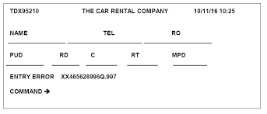

Slide 4
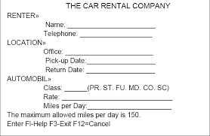
At 1980s screen design was improved by displaying clear and meaningful field captions, as well as showing commands on the screen and allowing them to be executed using function keys. Messages became clearer as well.

Slide 5
In the 1990s, our understanding of what makes a good screen design grew even more.
Different font sizes and styles, line thickness, and colors were also supplied as characteristics of elements. Many other types of controls were added to the entry field, such as list boxes, drop-down combo boxes, spin boxes, and so on.
These updated controls were significantly more helpful in boosting users experience, as they now just allow selection from a list rather than needing a key entry to be recalled. Completion aids were removed from screens, and new listing controls were added in their place.

Slide 6
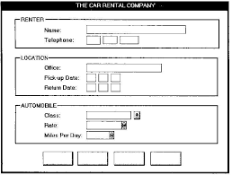

Slide 7
What screen users want?
A look that is neat, clear, and clutter-free.
A clear indication of what is being displayed and how it should be used.
Expected information is in the right place.
There is a clear indication of what is connected to what.
Plain and simple English

Slide 8
Screen Layout Guidelines:
Top left is where you'll find the most essential and often utilised items or controls.
Maintain top to bottom, left to right flow.
Aligning items, grouping elements, and using line borders to facilitate navigating through a screen

Slide 9
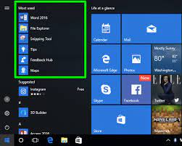
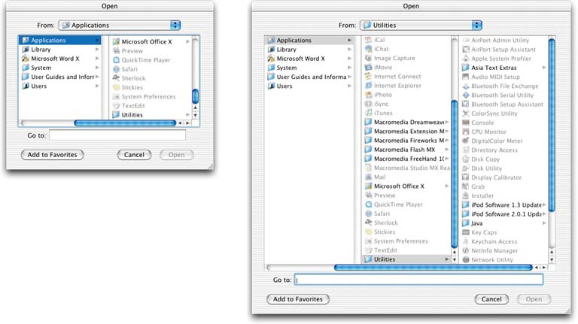
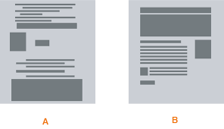

Slide 10
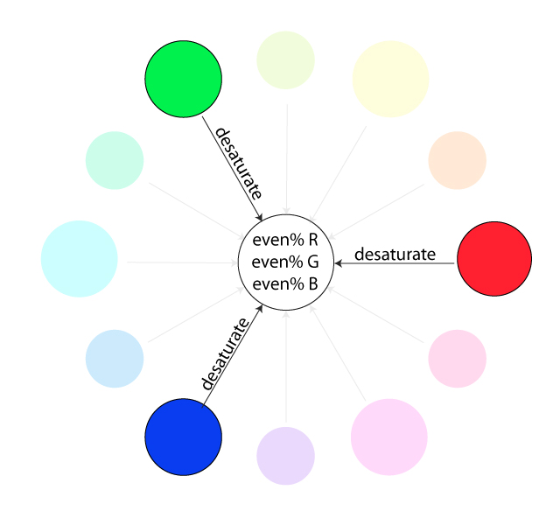
Consider that the eye tends to move sequentially, for example,
From dark to light areas, while establishing eye movement through a screen.
Objects ranging in size from large to small .
From odd to typical shapes.
From highly saturated to unsaturated colors.
These methods can be used to first focus a person's attention.

Slide 11
Focus & Emphasis:
Visually emphasize the
Most prominent element
Most important elements
Central idea or focal point
Deemphasize less important elements
You can use lines, shapes, colors, textures, size, etc., as well as many other elements to create emphasis.

Slide 12
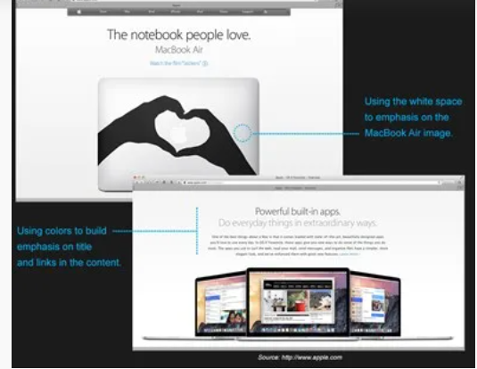

Slide 13
Provide information in a clear and concise manner.
Provide clarity
Provide readability
Present information in meaningful pattern

Slide 14
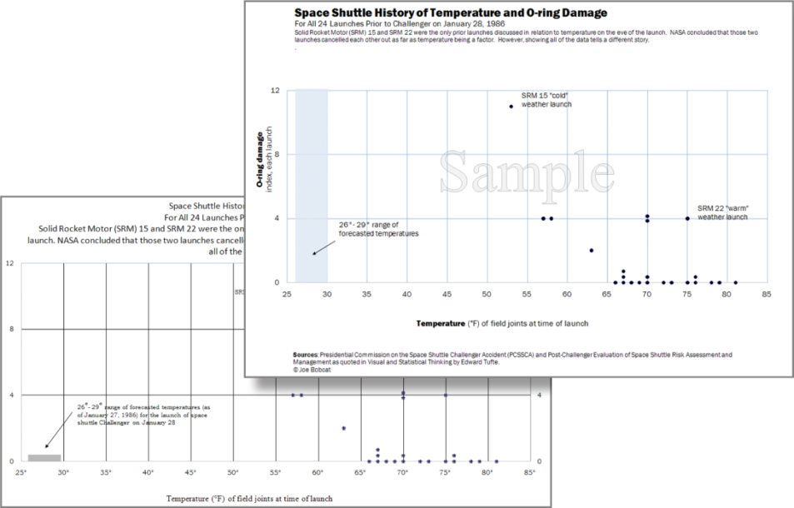
Four Design Principles
Contrast
Contrast draws our attention to a particular topic and should be used to emphasize the most significant aspects for the audience to remember.
To separate elements of text or an image and generate contrast, designers should employ colors, bold font, and size.
Formatting, including the use of a blue shape, creates contrast, drawing attention to important data points in the Excel graph.

Slide 15

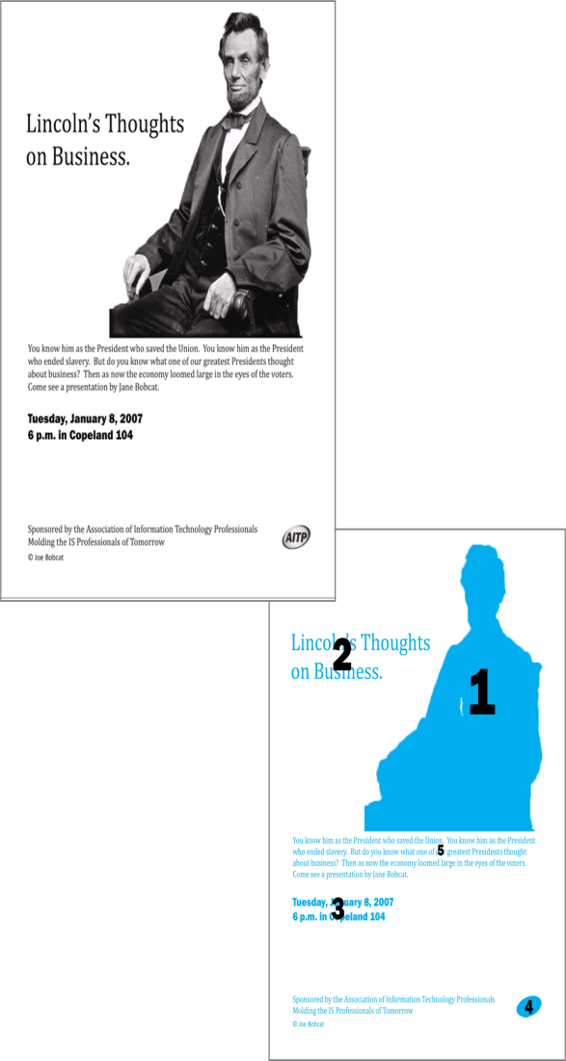
Contrast is created by formatting headings for the title and subtitles.
Take note of how your eye moves over this flyer in the numbered order shown.

Slide 16
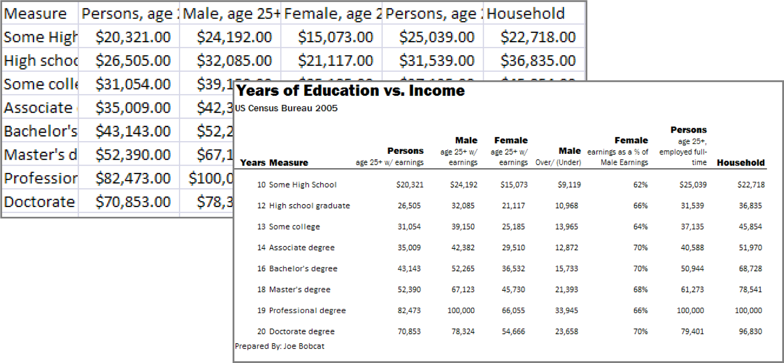
Repetition
Ties objects or images together.
Uses repetition of fonts, styles, and sizes to unify the design.
The repetition of formatting in the text headings creates a unified professional look.

Slide 17
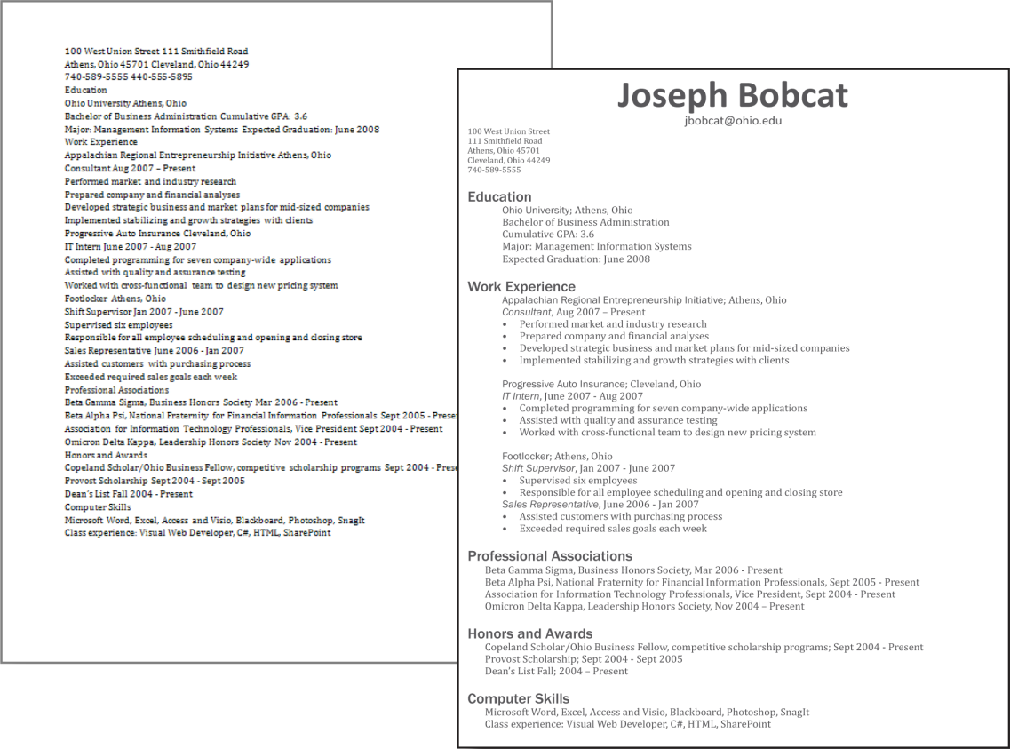
Alignment
Along an imagined line, arrange items that are connected.
When text on a page is properly aligned to the margin, it is easier to read and understand.
Every design should have alignment applied to it.
The alignment of text organizes the categories on the resume.

Slide 18
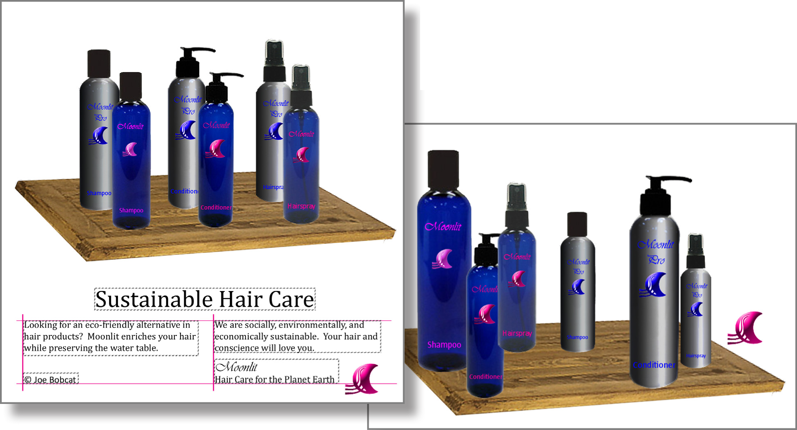
The alignment of text and images in this ad creates a polished and professional look

Slide 19
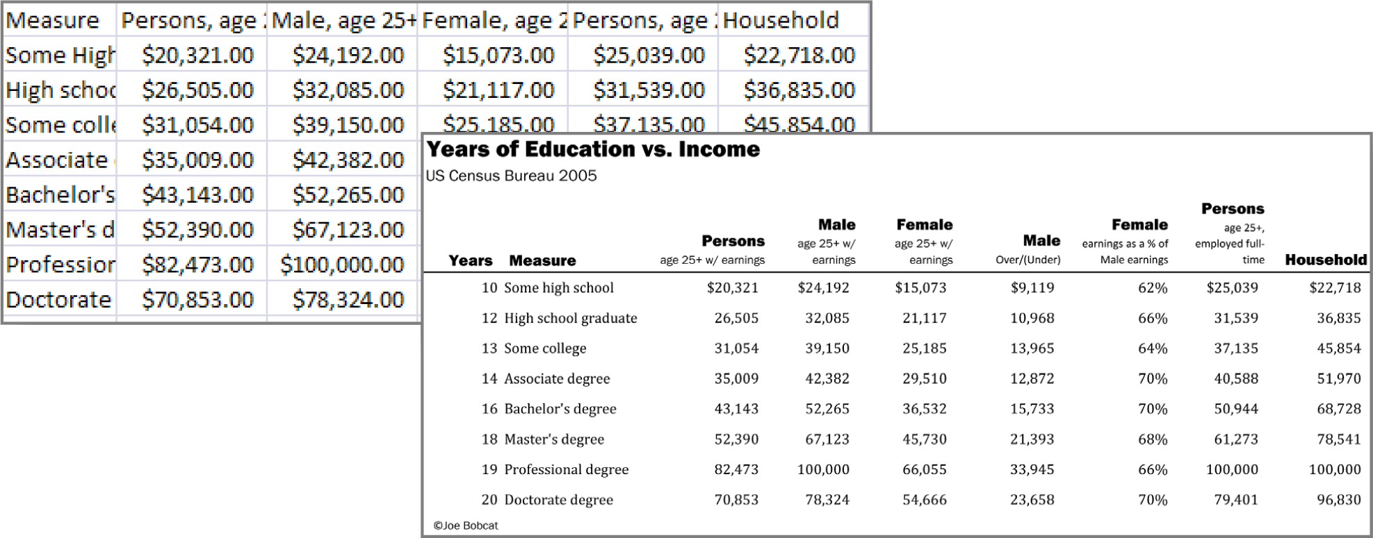
Proximity
Closely group content items that are related to one another.
Separate items that are unrelated
Proximity helps in the structuring of this Excel spreadsheet. The spreadsheet's title and subtitle are separated from the rest.

Slide 20
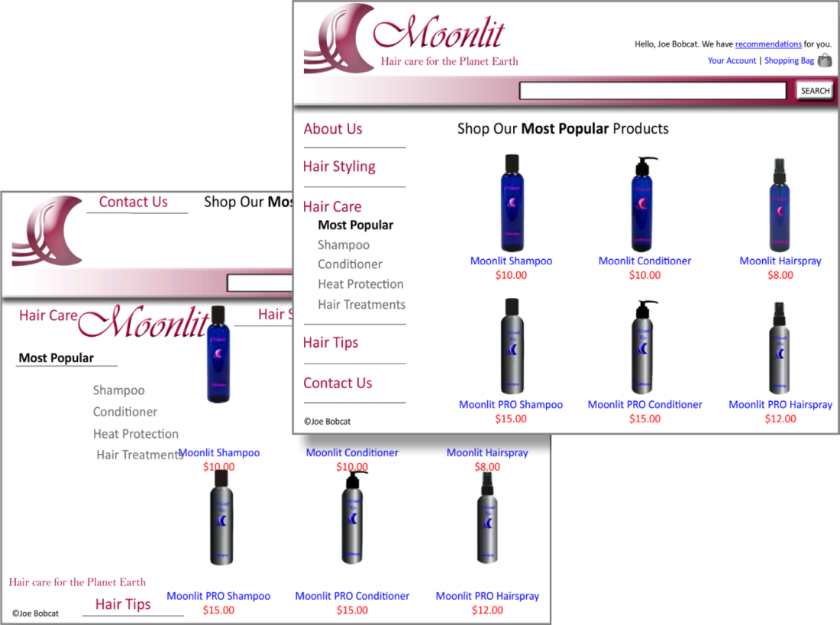
For example, captions placed near photos on a page layout show that they describe the photos they are near
The navigation bar's links are grouped by proximity. Each bottle's image, title, and price are also grouped together.

Slide 21
THANK YOU

